Slide 1
Intro to
ML
Session - 2

Slide 2

About Speaker
Amrithesh Kakkoth
Community Lead

Slide 3
UNSUPERVISED LEARNING
Unsupervised learning is a branch of machine learning that deals with unlabeled data.
Unlike supervised learning, where the data is labeled with a specific category or outcome, unsupervised learning algorithms are tasked with finding patterns and relationships within the data without any prior knowledge of the data's meaning.

Slide 4
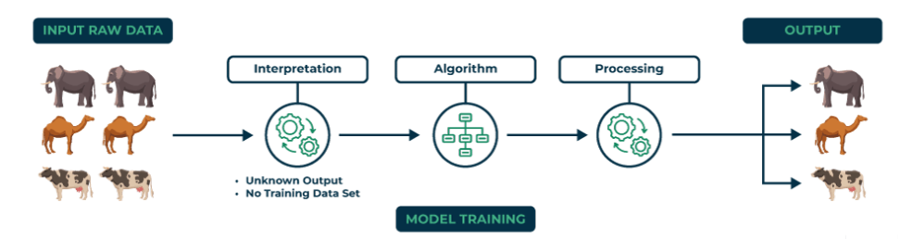

Slide 5
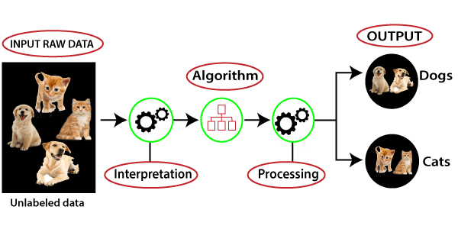

Slide 6
Applications:
Customer Segmentation: Algorithms cluster customers based on purchasing behavior or demographics, enabling targeted marketing strategies.
Anomaly Detection: Identifies unusual patterns in data, aiding fraud detection, cybersecurity, and equipment failure prevention.
Image and Text Clustering: Groups similar images or documents for tasks like organization, classification, or content recommendation.

Slide 7
Unsupervised learning algorithms:
There are mainly 3 types of algorithms for unsupervised learning:
Clustering
Association Rule Learning
Dimensionality Reduction
Today we are going to take a look at Clustering
Clustering in unsupervised machine learning is the process of grouping unlabeled data into clusters based on their similarities.
One of the common algorithm used for clustering is K-Means Clustering

Slide 8
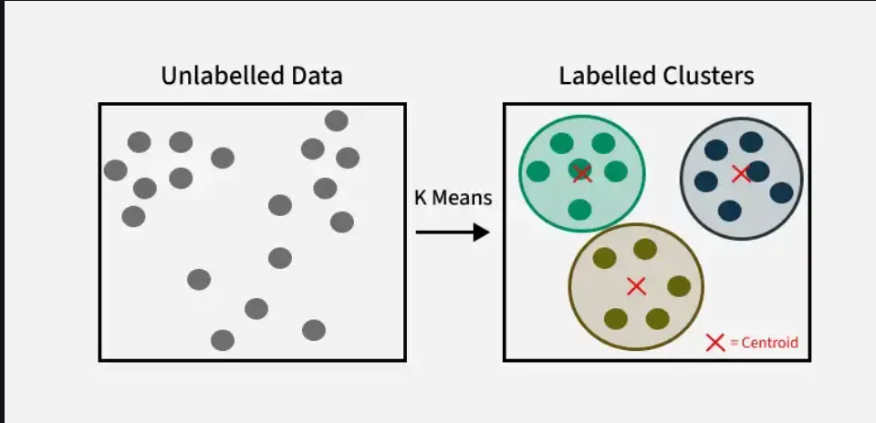
K-MEANS CLUSTERING

Slide 9
The algorithm will categorize the items into k groups or clusters of similarity. To calculate that similarity we will use the Euclidean distance as a measurement.
Data points that are nearest to a centroid are grouped together within the same category.
A higher k value, or the number of clusters, signifies smaller clusters with greater detail, while a lower k value results in larger clusters with less detail

Slide 10
How it works?
Initialize k centroids where k is equal to the number of clusters chosen for a specific dataset
Randomly initialize K centroids
Assign each data point to the nearest centroid
Recalculate the centroid of each cluster.
This process repeats until the centroid positions have reached convergence or the maximum number of iterations have been reached.

Slide 11
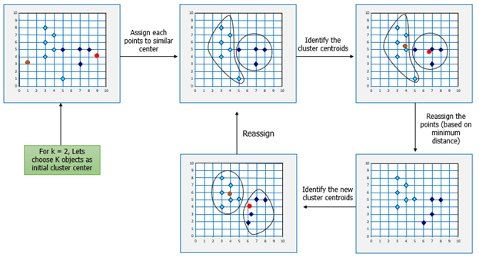

Slide 12
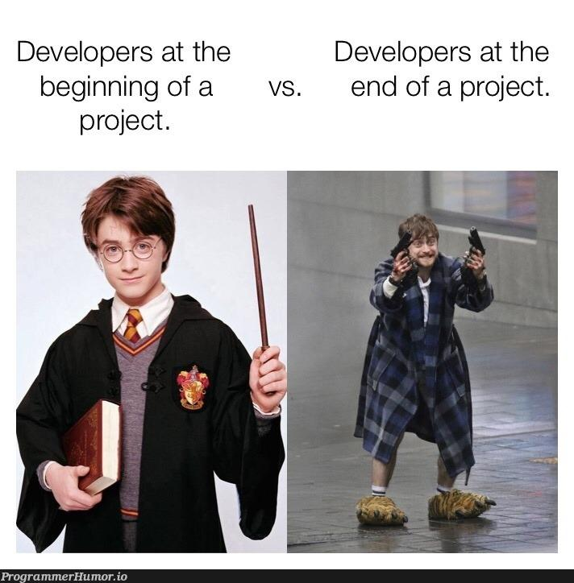
Intro to the Project

Slide 13
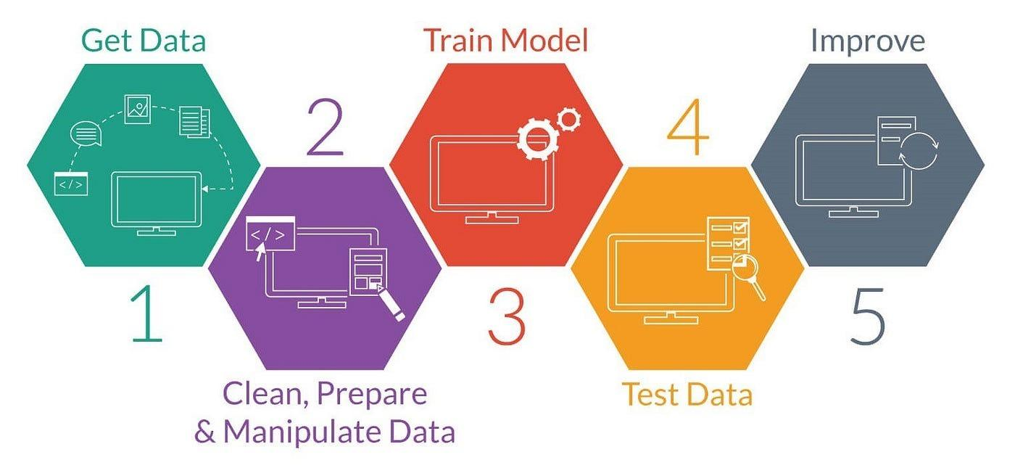

Slide 14
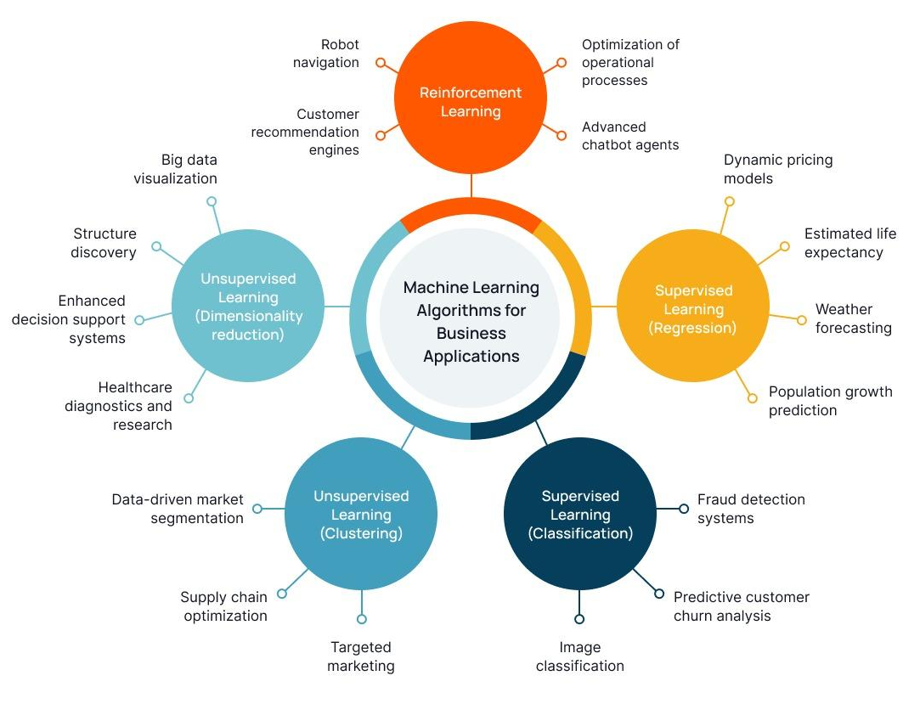

Slide 15
The dataset used in this project is nprak26/remote-worker-productivity, hosted on Hugging Face. It’s a tabular dataset in CSV format
The dataset’s labeled structure makes it an excellent candidate for:
Predict productivity based on demographic, work environment, and behavioral attributes.
Apply classification models to categorize workers into productivity tiers or satisfaction levels.
Use regression models to estimate continuous outcomes such as productivity score, task completion rate, or quality score.
Evaluate feature importance to understand which factors most strongly influence productivity and performance.

Slide 16
Data Handling
Goal: Ensure the dataset is accurate, consistent, and ready for modeling.
Handling Missing Values (NaNs)
Drop irrelevant or heavily missing columns.
Impute missing values using mean/median (numeric) or mode (categorical).
Correcting Bad Entries
Fix typos, inconsistent categories (e.g., "Male", "M", "male").
Remove unrealistic or outlier values if unjustified.
Dropping Unnecessary Columns
Remove columns with no predictive power (IDs, duplicates, irrelevant timestamps).

Slide 17
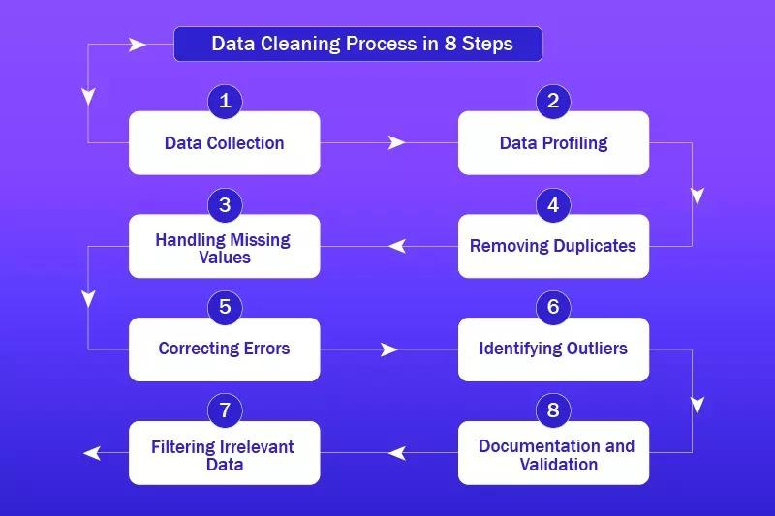

Slide 18
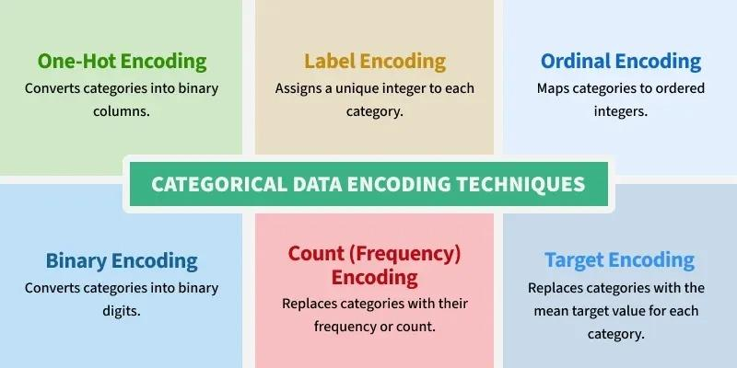
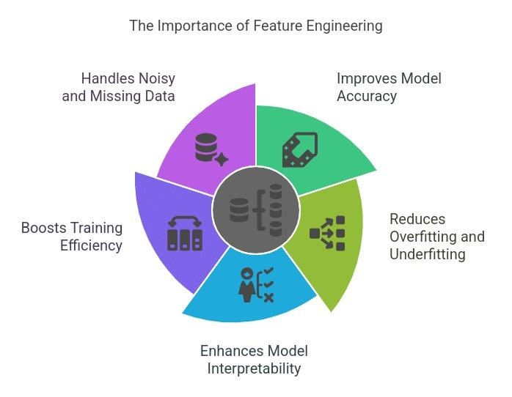
Data Transformation & Scaling
Goal: Make features machine-learning-friendly.
Normalization & Standardization
Normalize data to bring all numeric features to a similar scale.
Standardize for algorithms sensitive to variance (SVM, K-Means, Logistic Regression).
Encoding Categorical Variables
One-Hot Encoding for nominal categories.
Label Encoding for ordinal data.
Feature Engineering
Create new features from existing ones (e.g., “Meetings per Week” / “Total Hours”).
Combine or split features for better interpretability.

Slide 19
Data Balancing & Pattern Exploration
Goal: Ensure fair learning and uncover insights
Handling Imbalanced Data
Why? Imbalance can cause the model to favor the majority class, reducing prediction quality for minority classes.
Oversampling: Increase the number of minority class samples using techniques like SMOTE or random duplication.
Undersampling: Reduce the majority class size to match the minority, preventing bias but possibly losing information.
Hybrid approaches: Combine oversampling and undersampling for optimal balance.

Slide 20
Exploratory Data Analysis (EDA)
Purpose: Understand the dataset before modeling, identify relationships, and spot anomalies.
Pattern Detection: Find trends in productivity based on demographics, work conditions, or behavior.
Correlation Analysis: Use correlation matrices to see which factors are linked to productivity scores.
Visualization Tools:
Histograms: Show distribution of key variables.
Heatmaps: Highlight correlations and feature interactions.
Scatter Plots: Reveal relationships between two variables.
Outlier Detection: Identify extreme values that could skew results.

Slide 21
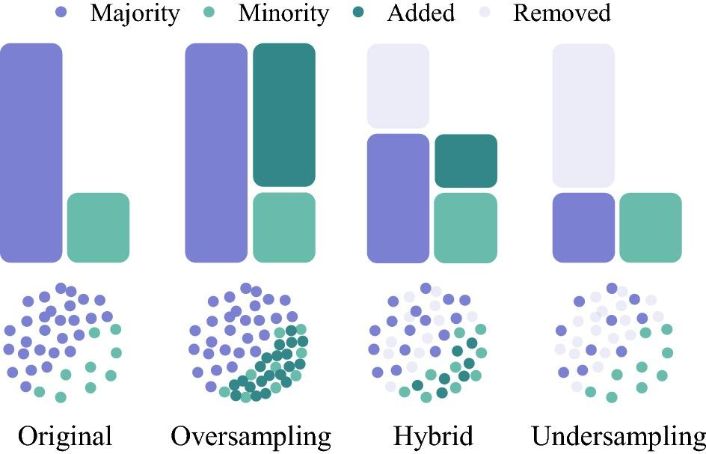

Slide 22
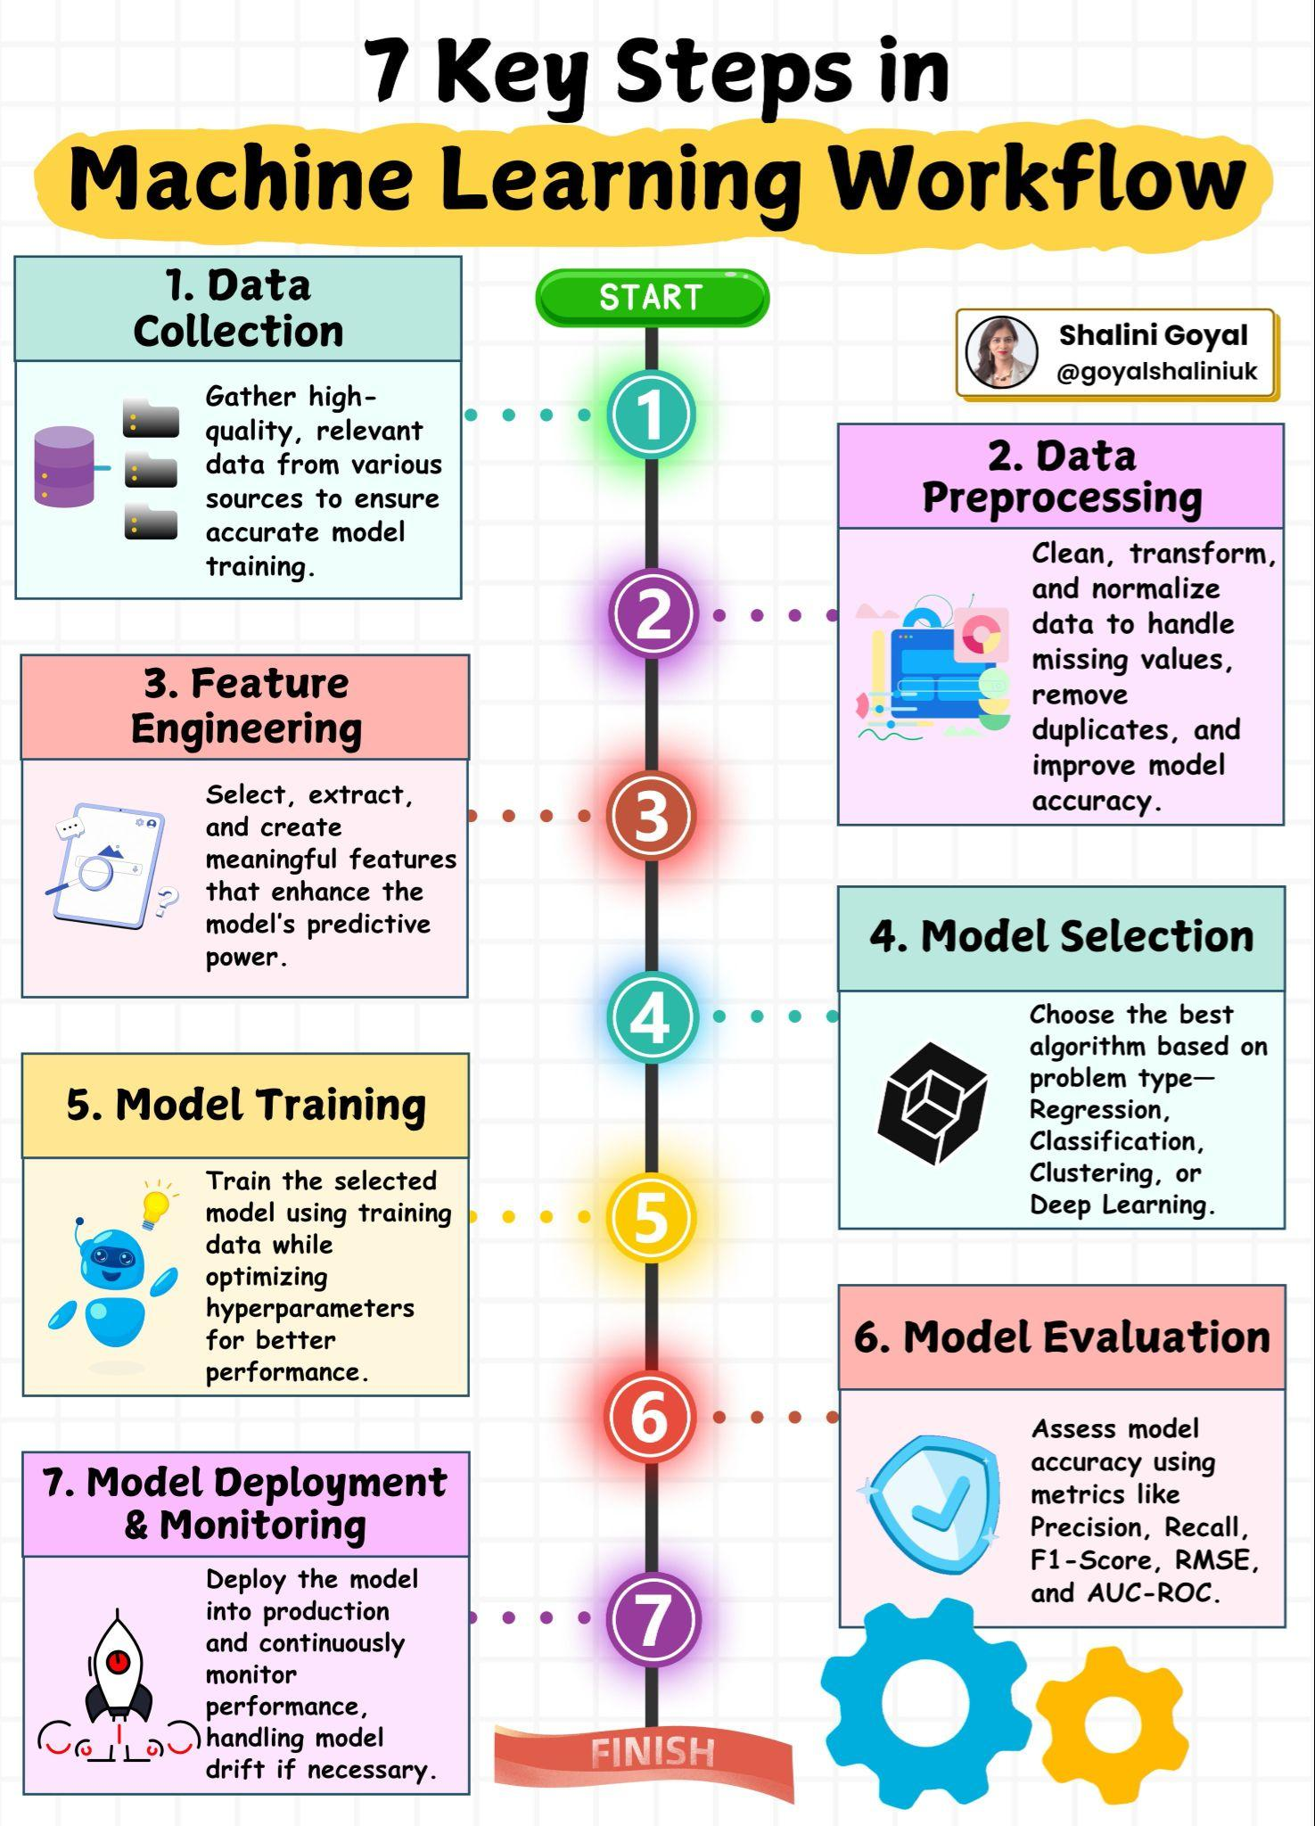
Machine Learning Project Building
Key Steps:
Problem Definition & Data Collection
Data Preprocessing (cleaning, feature engineering)
Model Selection & Training
Model Evaluation using metrics
Deployment & Monitoring

Slide 23
Preparing Your Data
Handle Missing Values:
Drop rows/columns or fill with mean/median/mode
Encode Categorical Data:
Label Encoding: A=1, B=2, C=3
One-Hot Encoding: Create binary columns
Feature Scaling:
Normalization: Scale to 0-1 range
Standardization: Mean=0, Std=1
Train-Test Split:
Standardization: Mean=0, Std=1

Slide 24
Choosing the Right Algorithm
For Classification:
Logistic Regression: Linear relationships, interpretable
Decision Tree: Easy to understand, handles mixed data types
Random Forest: More robust than single tree, handles overfitting
SVM: Good for high-dimensional data
K-NN: Simple, good baseline model
For Regression:
Linear Regression: Simple linear relationships
Decision Tree Regressor: Non-linear patterns
Random Forest Regressor: Robust ensemble method

Slide 25
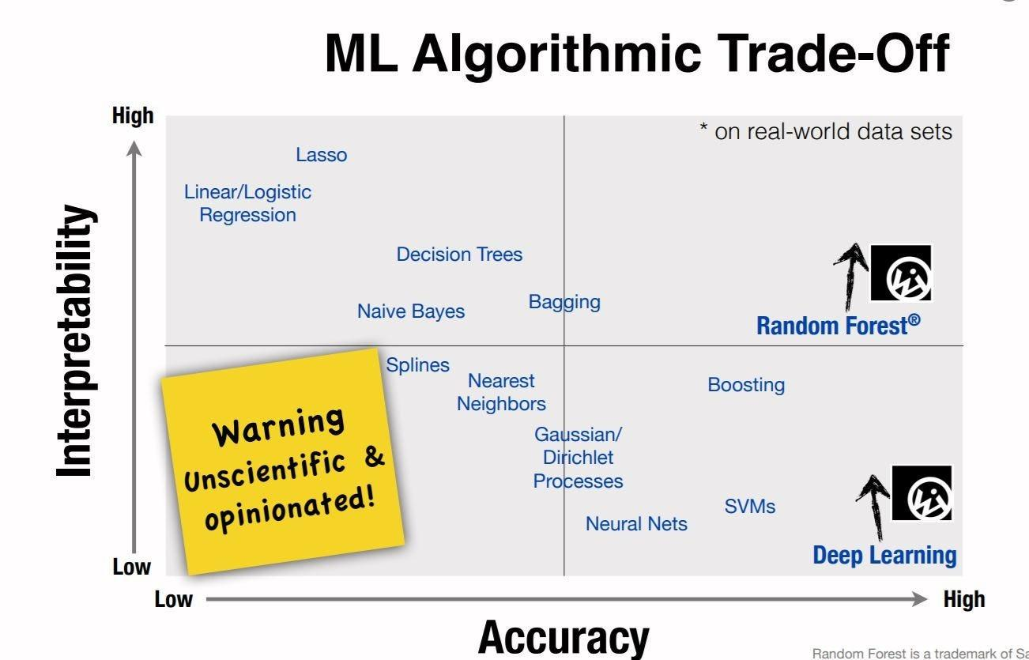

Slide 26
Measuring Model Performance
For Classification:
Accuracy: Overall correctness = Correct Predictions / Total Predictions
Precision: TP / (TP + FP) - "Of predicted positives, how many were right?"
Recall: TP / (TP + FN) - "Of actual positives, how many did we find?"
F1-Score: Balance of Precision & Recall
For Regression:
MAE: Mean Absolute Error - average difference
RMSE: Root Mean Squared Error - penalizes large errors

Slide 27
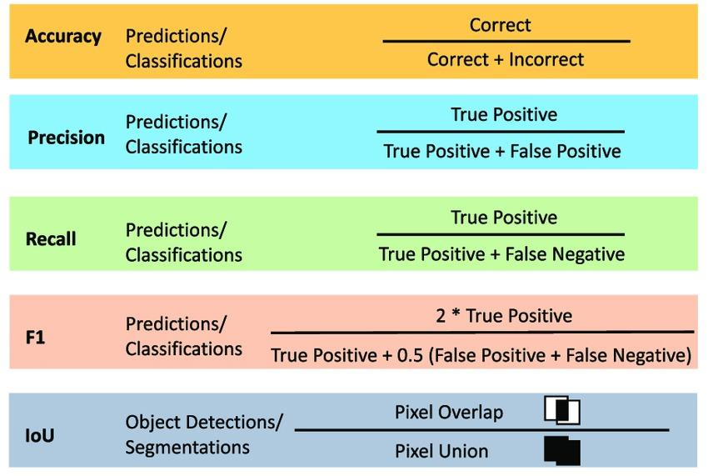

Slide 28
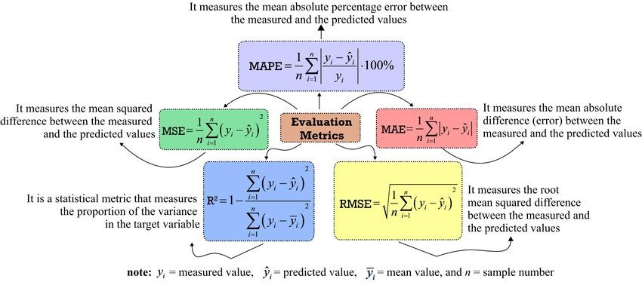

Slide 29
Avoiding Common Pitfalls
Train-Test Split: 80% training, 20% testing
Cross-Validation: Use K-fold for better estimates
Overfitting vs Underfitting:
Overfitting: Great on training, poor on test +data
Solution: More data, regularization, simpler model

Slide 30
